Slide 1
Q-Learning Maze Solver with Variable Grid Size
Made By: Ahmed Gaber
Presented To: Dr.Tarek Ghonimey

Slide 2
Table of content
Introduction and Problem Definition
Fundamentals of Reinforcement Learning
Overview of the Q-Learning Algorithm
System Design and Architecture
Implementation Methodology
Experimental Results and Analysis
Challenges Encountered and Solutions
Future Enhancements and Work
Live Demonstration

Slide 3

01
Introduction
You can enter a subtitle here if you need it

Slide 4
Introduction
Implementation of Q-learning reinforcement learning algorithm
for solving maze navigation problems with variable grid sizes
Problem Domain
Autonomous navigation in unknown environments
Path planning in the presence of obstacles
Learning optimal behavior without prior knowledge
Key Questions
How can an agent learn the best path through a maze?
How do learning parameters affect performance?
Can the agent handle new, unseen environments?

Slide 5
Project Goals
Implement Q-learning from scratch
Build a flexible maze environment
Study the effect of different parameters
Visualize the learning process
Evaluate performance on different grid sizes

Slide 6
02
Reinforcement Learning Fundamentals

Slide 7
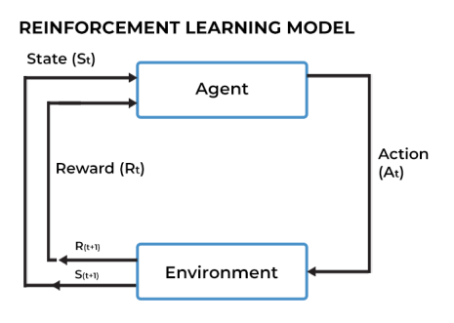
RL Framework

Slide 8
Key Components
Agent: The learning entity that interacts with the environment
Environment: A maze defined by states, actions, and rewards
State (s): The agent’s current position (row, column)
Action (a): Possible movements (up, right, down, left)
Reward (r): Feedback received after taking an action
Policy (π): The strategy used to choose actions

Slide 9
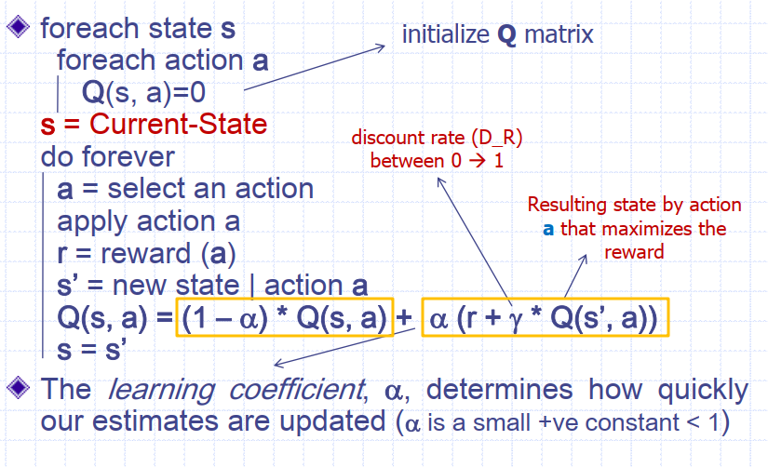
Q-Learning Algorithm

Slide 10
Q-Learning Algorithm
Q(s, a): Estimated value of taking action a in state s
α (Learning Rate): Controls how much new information overrides old values (0 ≤ α ≤ 1)
r (Reward): Immediate feedback after an action
γ (Discount Factor): Importance of future rewards (0 ≤ γ ≤ 1)
maxₐ′ Q(s′, a′): Maximum expected future reward from the next state
ε-greedy strategy balances exploration (try new actions) and exploitation (use known best actions)

Slide 11
03
System Architecture

Slide 12
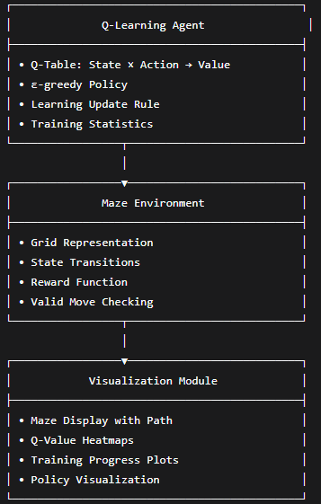
System Architecture
Component Diagram

Slide 13
04
Implementation Details

Slide 14
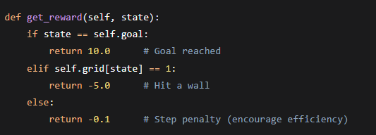
Implementation Details
Reward Function

Slide 15

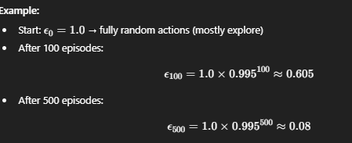
Q-Learning Numerical Example
At the beginning the robot is explore doesn’t know anything Epsilon =1

Slide 16
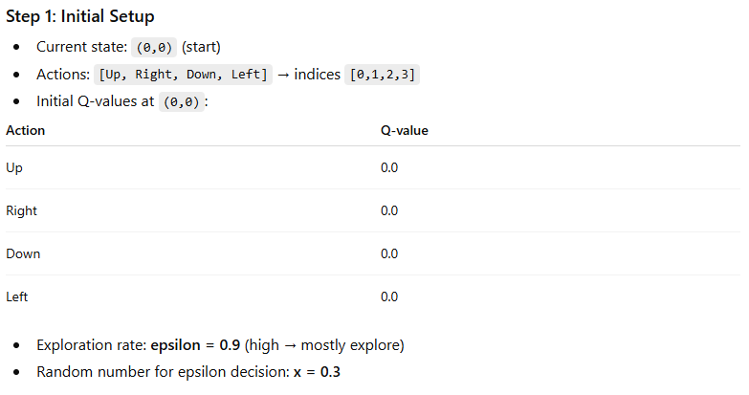
Q-Learning Numerical Example

Slide 17
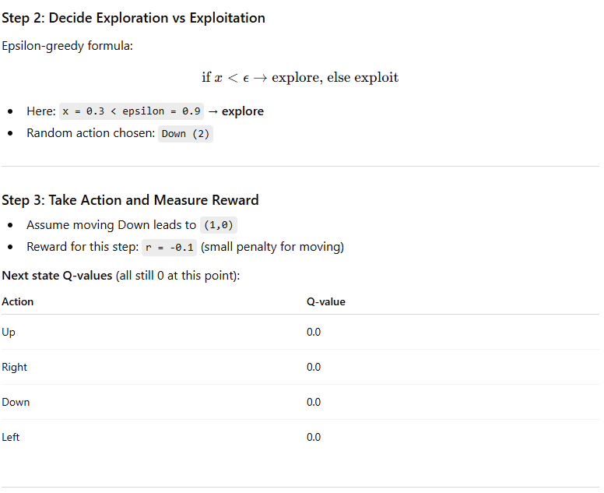
Q-Learning Numerical Example

Slide 18
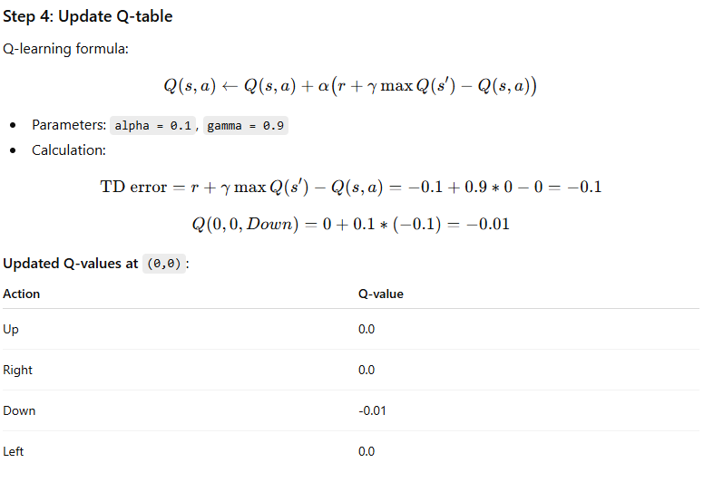
Q-Learning Numerical Example
Now the agent learned Down is slightly bad.

Slide 19
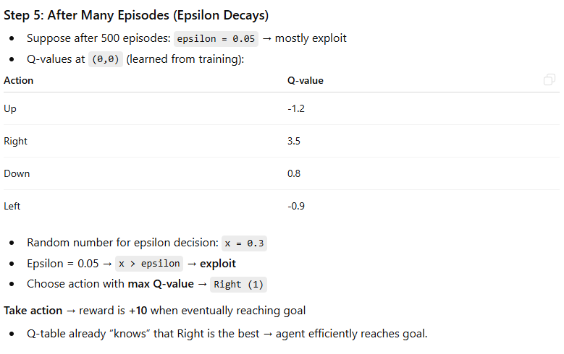
Q-Learning Numerical Example

Slide 20
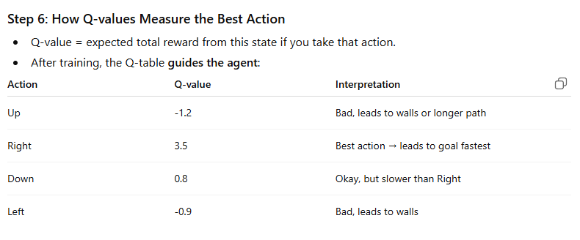
Q-Learning Numerical Example

Slide 21
Parameter Configuration
Parameter | Typical Range | Effect
Learning Rate (α) | 0.01 – 0.5 | Controls convergence speed
Discount Factor (γ) | 0.8 – 0.99 | Determines importance of future rewards
Initial ε | 0.5 – 1.0 | Sets initial exploration level
ε Decay | 0.99 – 0.9999 | Controls rate of exploration reduction

Slide 22
05
Results & Analysis

Slide 23
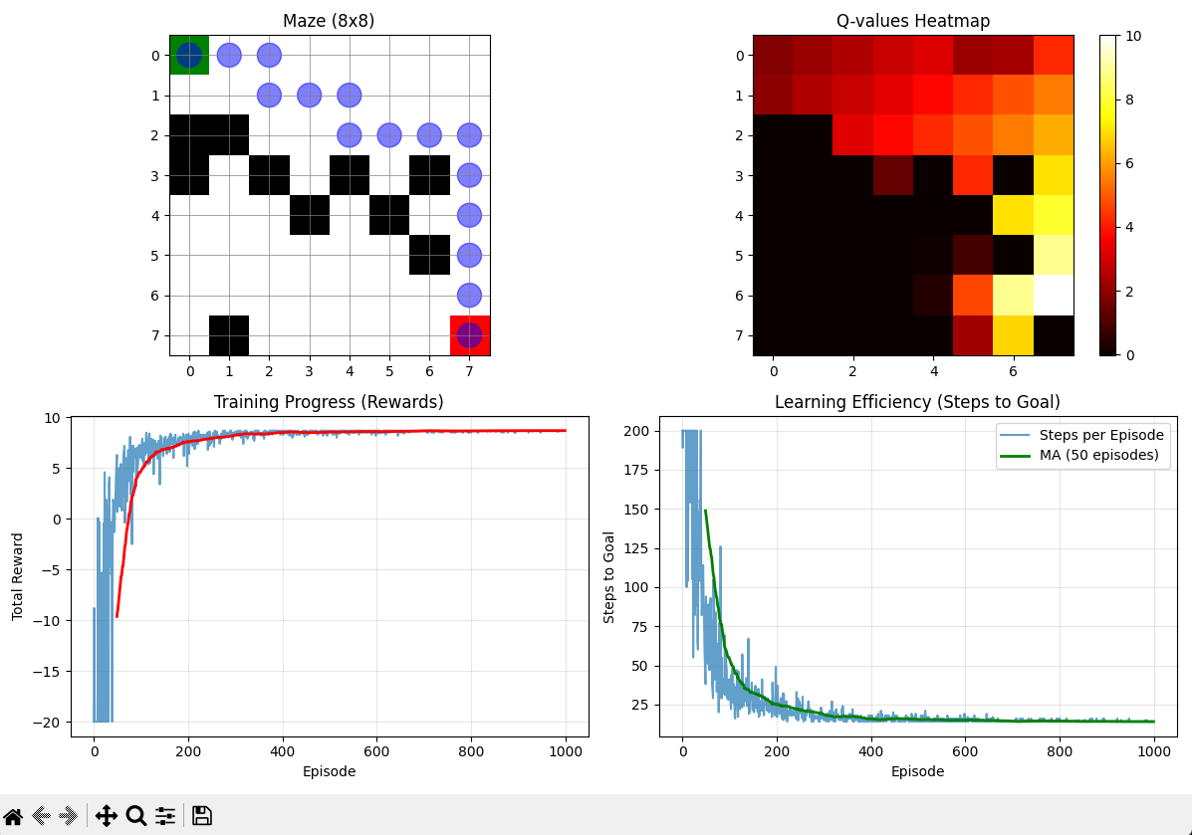
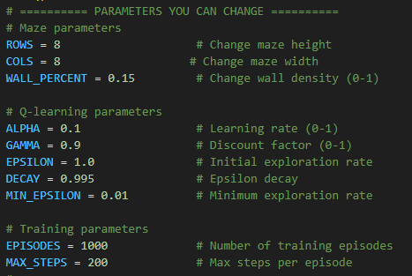
Performance Metrics

Slide 24
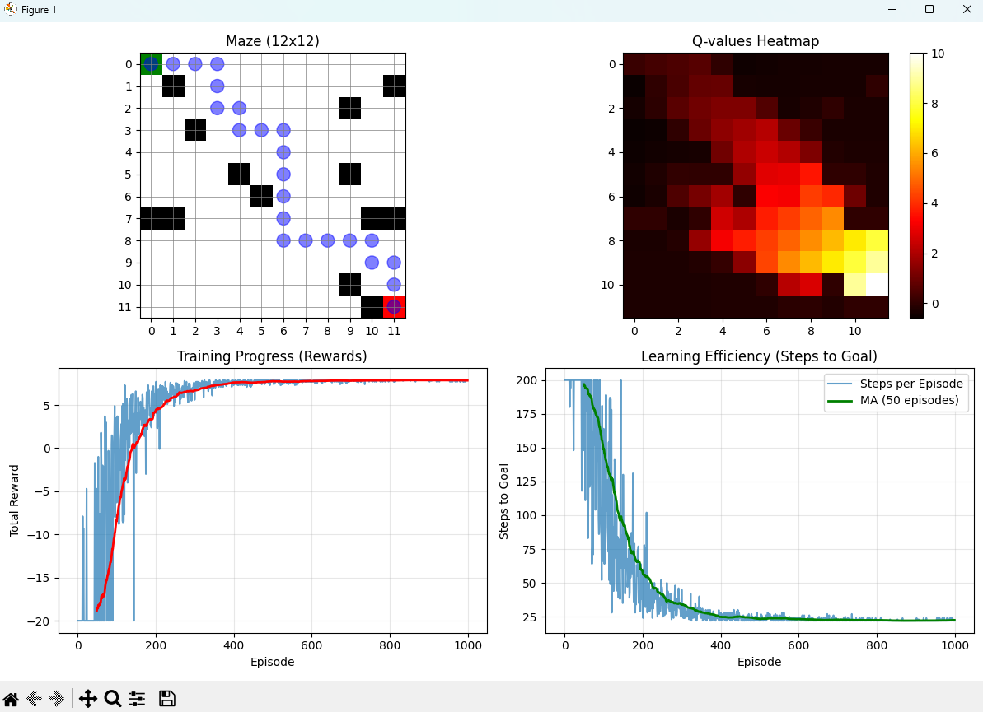
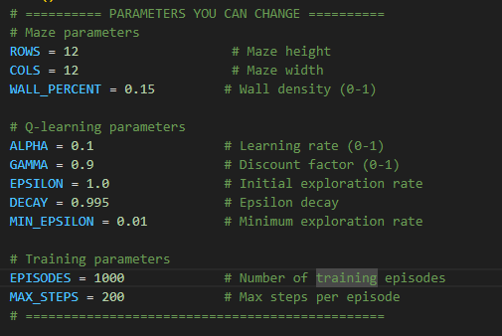
Performance Metrics

Slide 25
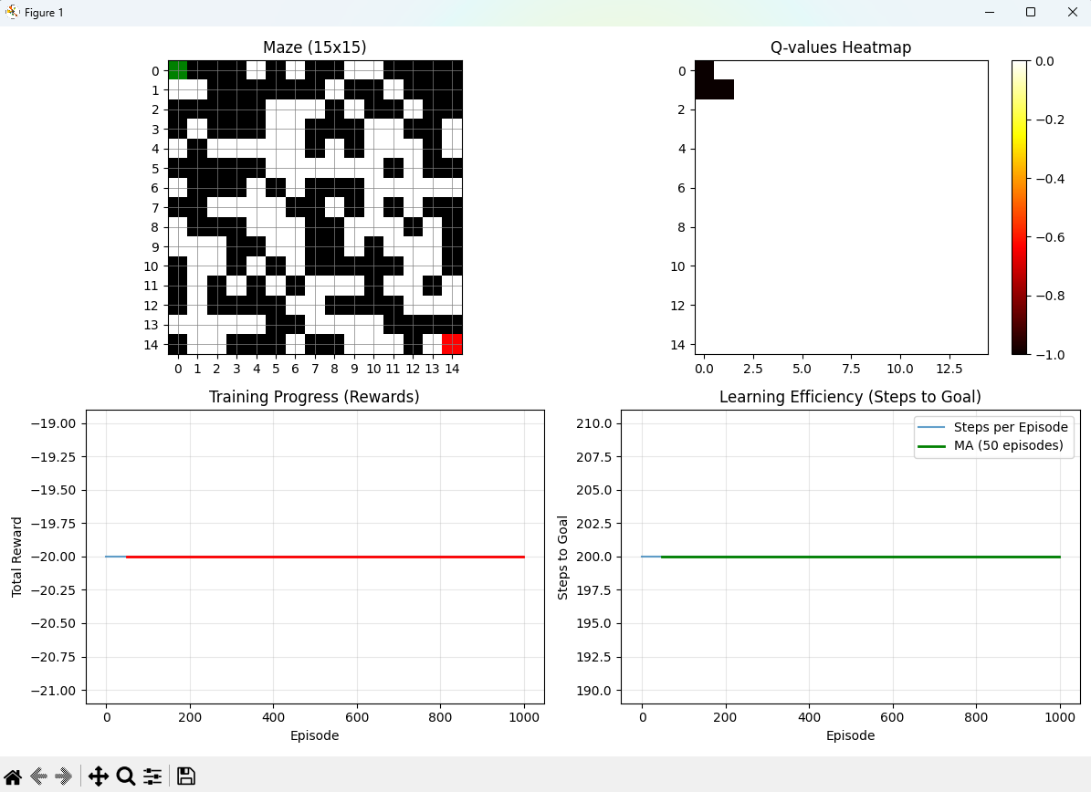
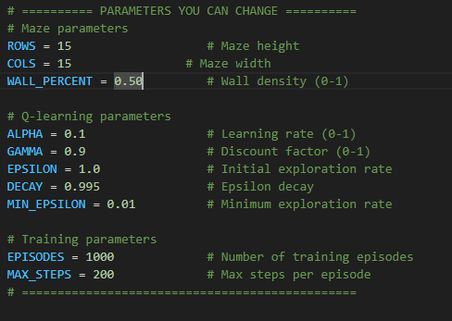
Performance Metrics
No solution

Slide 26
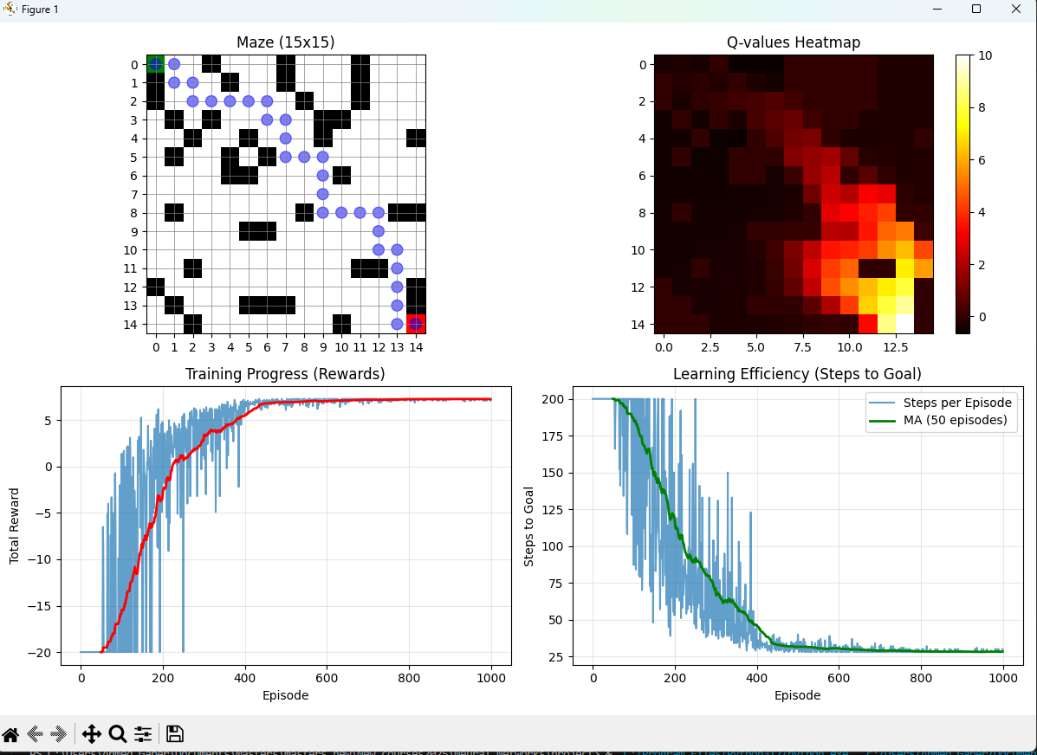
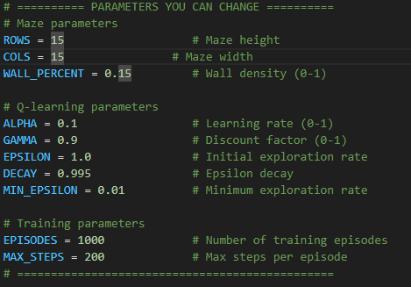
Performance Metrics

Slide 27
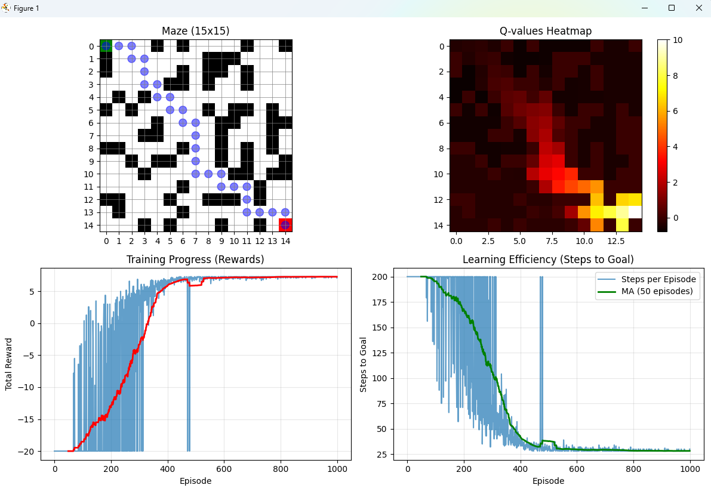
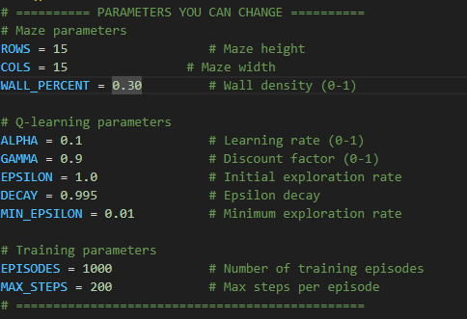
Performance Metrics

Slide 28
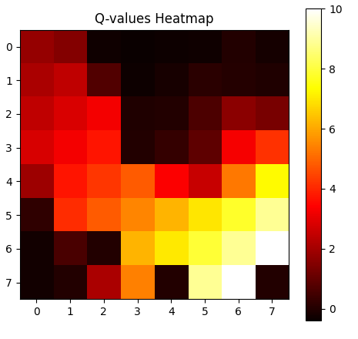
Q-Value heatmap
The heatmap shows the maximum Q-value for each state in the maze.
Color intensity:
Dark (low Q-value) → states less valuable or rarely visited.
Bright (high Q-value) → states closer to the goal or important for reaching it.
The agent assigns higher values to states that lead more directly to the goal
Notice how the Q-values increase along the path from start to goal (bright regions along the learned path).

Slide 29
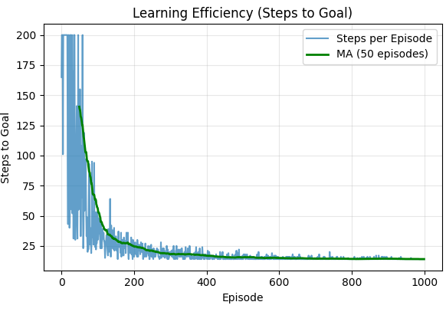
Learning efficiency
Learning efficiency tells us how quickly and consistently the agent is improving at solving the maze
The Problem with Raw Data:
Episode 1: 200 steps
Episode 2: 30 steps
Episode 3: 180 steps
Exploration (random actions) creates spikes and drops
The Solution: 50-Episode Moving Average:
Takes the average of the last 50 episodes for each point
Smooths out temporary fluctuations
Reveals the true learning trajectory

Slide 30
Training Progress Visualization
Metric | How It Is Measured | Observed Result
Average Reward | Mean cumulative reward per episode | −12.45 → 8.76
Steps to Goal | Average number of steps to reach the goal | 58 → 14
Success Rate | Successful episodes ÷ total episodes | 12% → 94%
Convergence Time | Episode where learning stabilizes | ~350 episodes

Slide 31
Key Findings
1. Grid Size Scalability
Small (3×3 – 5×5): Learn in < 200 episodes
Medium (6×6 – 10×10): Learn in 500–1000 episodes
Large (>10×10): Require > 2000 episodes
2. Wall Density Impact
<10% walls: Easy navigation
10–30% walls: Optimal learning challenge
>30% walls: High chance of unsolvable mazes

Slide 32
Optimal Parameter Settings
For 8×8 maze with 20% walls:
α = 0.15 (Learning Rate)
γ = 0.92 (Discount Factor)
ε_start = 1.0 (Initial Exploration)
ε_decay = 0.995
Early episodes: Random exploration
Middle episodes: Learning shortest paths
Late episodes: Optimized policy convergence

Slide 33
8. Challenges & Solutions
1. Exploration-Exploitation Tradeoff
Problem: Too much exploration slows learning; too much exploitation Solution: Adaptive ε-decay with minimum exploration
2. Sparse Rewards
Problem: Only reaching the goal gives positive reward → slow learning
Solution: Step penalty (-0.1) and wall penalty (-5) guide learning
3. State Space Explosion
Problem: Larger grids exponentially increase states
Solution: Tabular Q-learning effective up to 15×15; larger grids need function approximation
4. Convergence Validation
Problem: Knowing when the policy is optimal
Solution: Track moving average of rewards and steps to goal

Slide 34
06
Demo

Slide 35
Thank You

